Slide 1
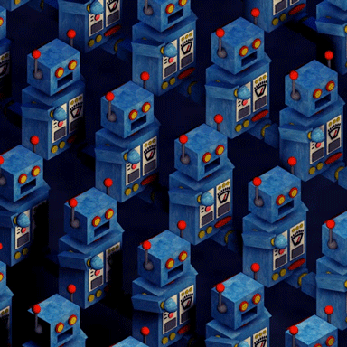
#BADBOT
Neha Gupta

Slide 2


Introduction
Identify bids that are placed by “Human” or “Bot”
Online bidding like eBay

Slide 3
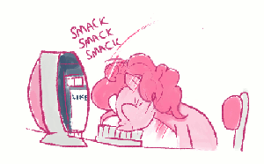
Problem Statement
Inability to win
Unfair Bidding
Human Engagement

Slide 4



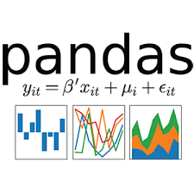
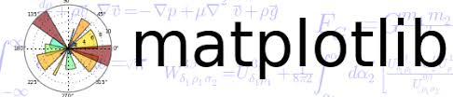


Process & Tools
Source
01
Data Analyzation
02
Feature Creation
03
Data Balancing
04
Model Fitting
05
Result Comparison

Slide 5
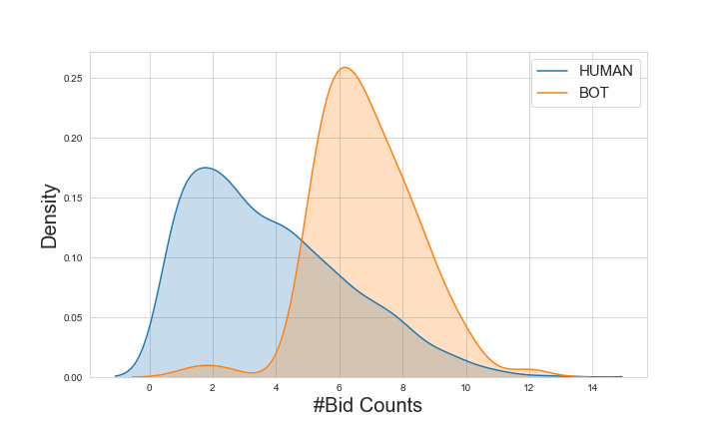
Interesting Facts of data

Slide 6
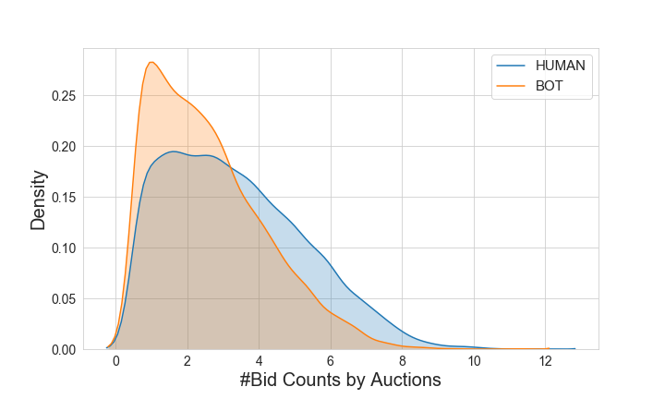
Interesting Facts of data

Slide 7
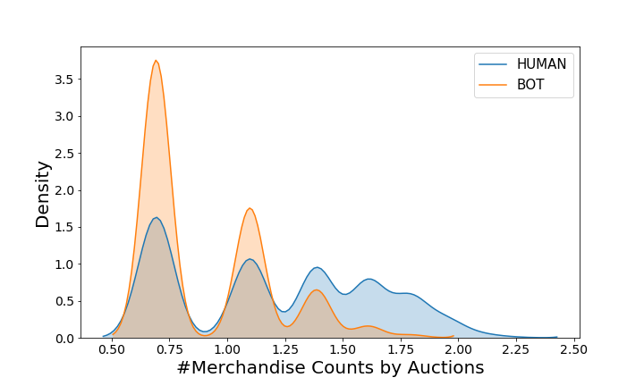
Interesting Facts of data
Bidder(Bot) | Merchandise | Bid Count
1 | Sporting Goods | 230326
1 | Mobile | 105138
1 | Jewelry | 37101
1 | Home Goods | 18708
1 | Computers | 11667

Slide 8
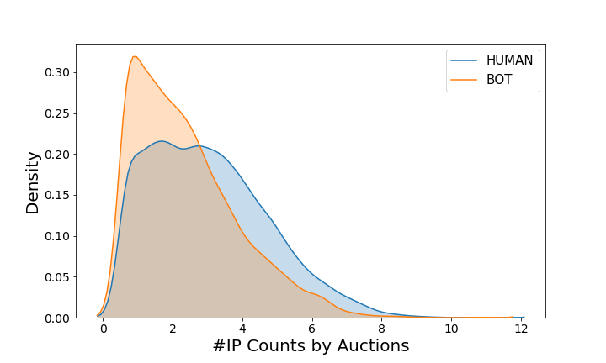
Interesting Facts of data

Slide 9

Evaluation Metric
MODEL | F1 SCORE
Logistic Regression | 0.790
KNN | 0.891
Decision Tree | 0.914
Random Forest | 0.946
SVM | 0.867
Naive Bayes | 0.568

Slide 10
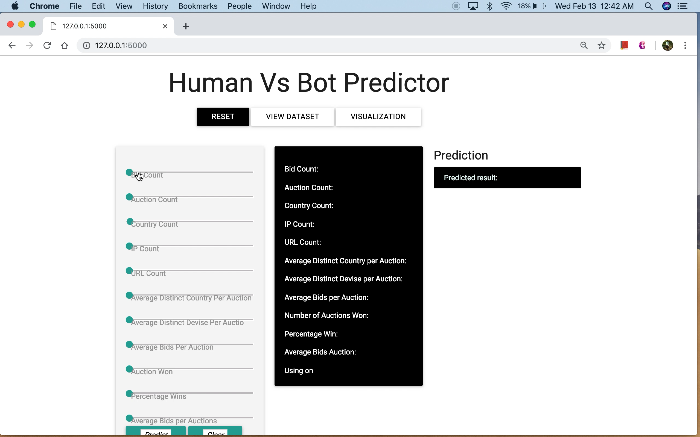

Slide 11

Conclusion
KNN best model
Bots do targeted bidding

Slide 12

Future Work
Time series feature
Improve the app

Slide 13
Thank you

Slide 14
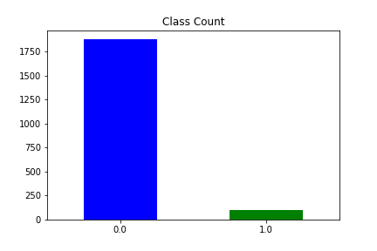
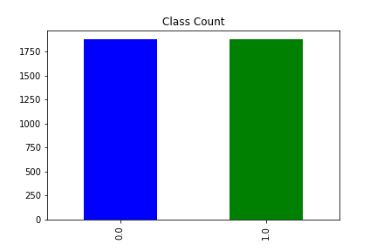
appendix
Data Balancing

Slide 15
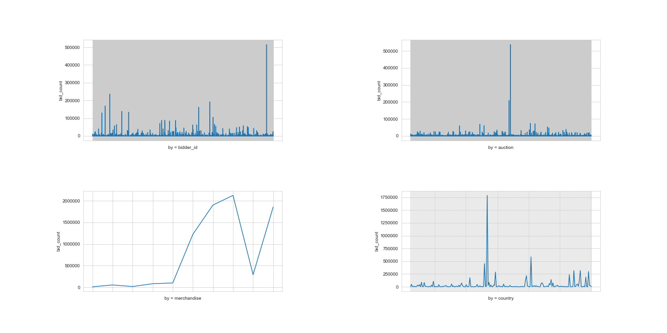
Data Exploration

Slide 16
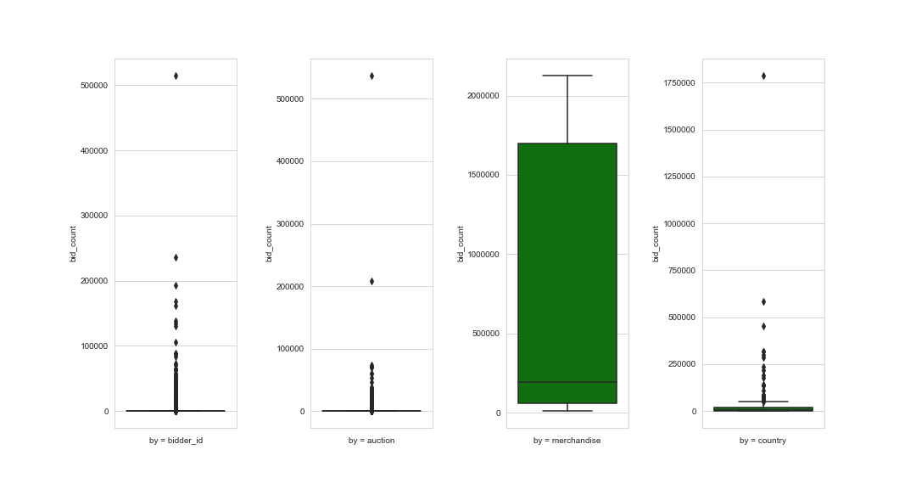
Data Exploration

Slide 17
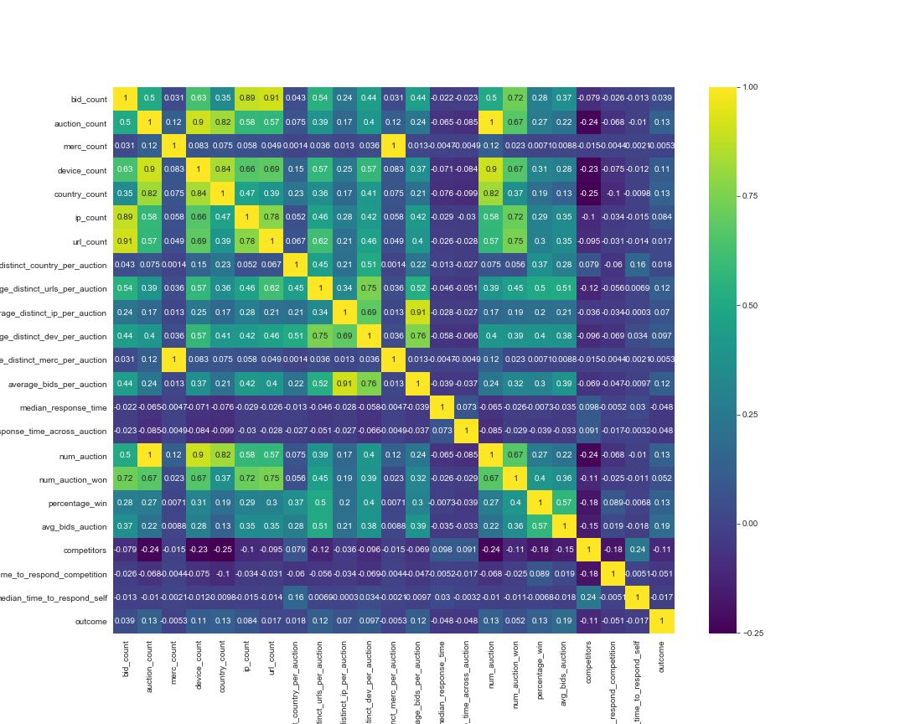
Feature Correlation

Slide 18
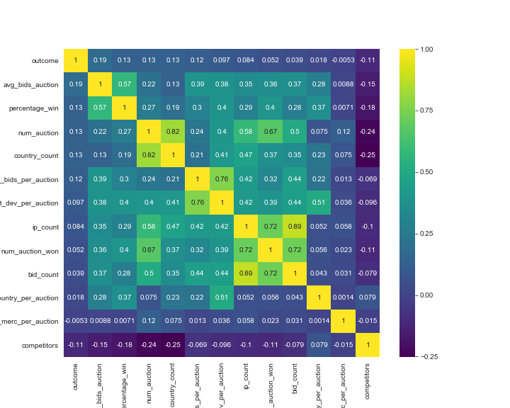
Feature correlation after removing highly corelated features

Slide 19
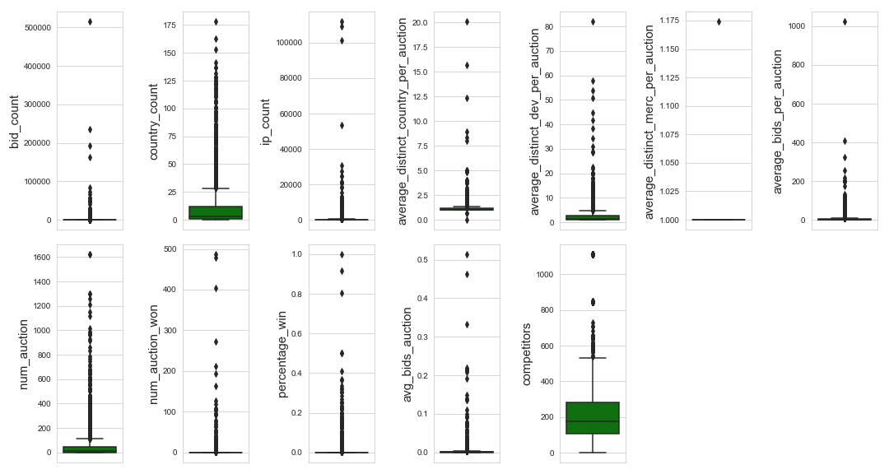
Feature Distribution

